Slide 1
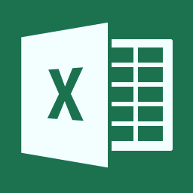

Excel Power Tools
Wen-ming Ye
Microsoft Corporation
Twitter: @wenmingye

Slide 2
Agenda
Excel Power Tools (Pivot, Map, View, Query)
LayerScape – MSR Visualization Tool
Data Nitro – Python + Excel

Slide 3

PowerPivot
(Excel)
Self-Service Analytics
Power Query
(New)
self-service data discovery, query, transformation and mashup
Data Market Place
Excel on HPC Cluster
StreamInsight
Complex Event Processing
PowerView
(Excel2013)
Data Visualization
PowerMap
(New)
Data Visualization
Microsoft Distribution of Hadoop
Notes:
Key point – MS big data solution is more than just Hadoop

Slide 4
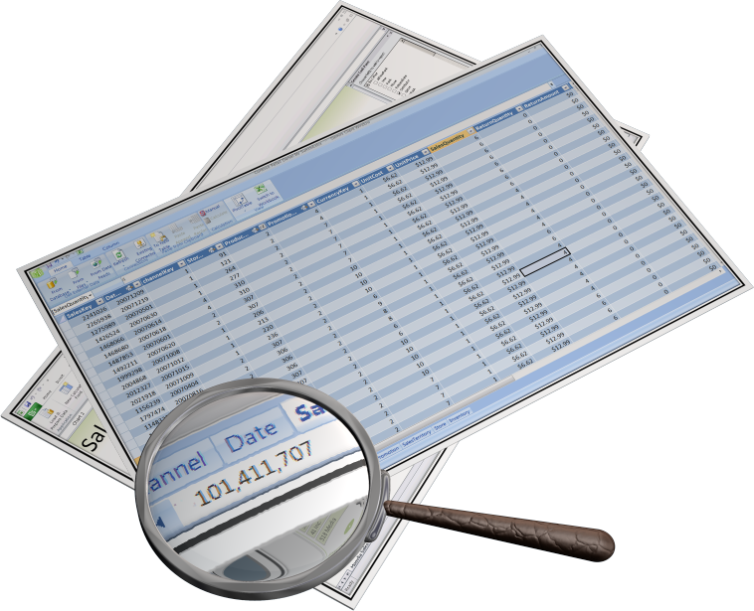
What is PowerPivot?
Create compelling self-service BI solutions
Using Familiar Excel Interface
BI Semantic Model
In memory compressed column store
Sophisticated Time Intelligence
Mashups

Slide 5
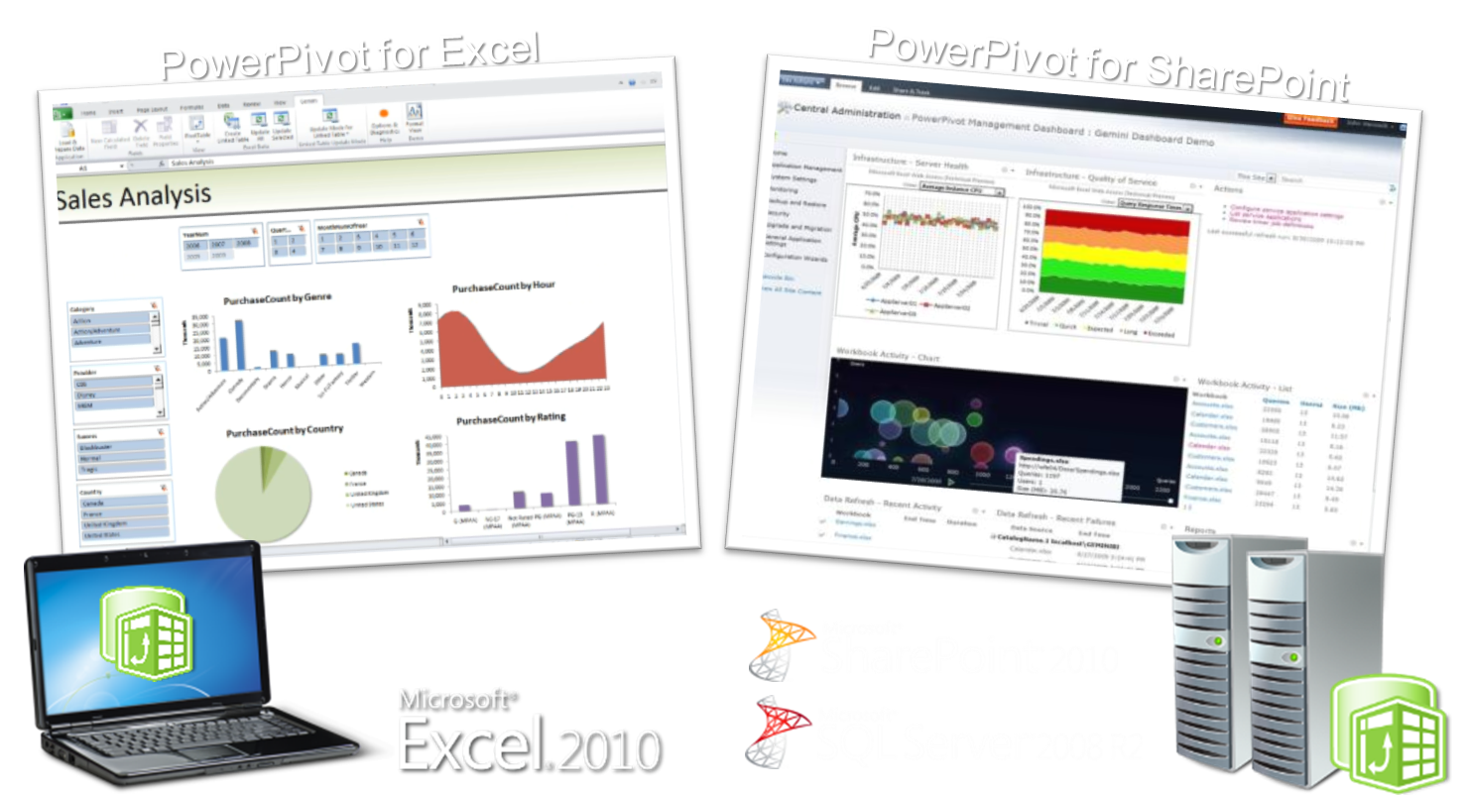
PowerPivot Versions

Slide 6
What is Power View?
Power View is an interactive data exploration and visual presentation experience

Slide 7






SharePoint Architecture
SharePoint Farm
SQL Server BIDS
BISM Model
Web Front End
App Server
SSRS Addin for SharePoint
RS Shared Service
Power View via Browser
AS Server
PowerPivot
System Service
PowerPivot
Web Service
Analysis Services SP Integrated
Excel PowerPivot
Model
Data sources

Slide 8







IT Pros
Power Users
Developers
End Users
Sophisticated Design Environment
Productive Authoring
Visual data representation
Report Viewer Controls
Re-use of insights
Highly Interactive
Rich Design Capabilities
Flexible layout
Rich Presentation
Report Designer / SSRS
Power Pivot
Power View
Embedded Operational Business

Slide 9
PowerPivot and PowerView
DEMOs
Notes:
http://office.microsoft.com/en-us/excel/power-bi-download-add-in-FX104087144.aspx

Slide 10
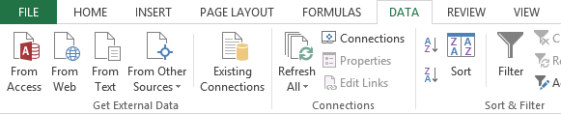
Current State of the Art

Slide 11
The Data tab – the old way

Slide 12
Modern experiences for getting data

Slide 13
Why Power Query?
Enable self-service data discovery, query, transformation and mashup experiences for Information Workers, via Excel and PowerPivot
Search, Discover, and connectivity to a wide range of data sources, including publicly available data of all sizes & shapes.
Highly interactive and intuitive experience for rapidly and iteratively building queries over any data source, any size.
Consistency of experience, and parity of query capabilities over all data sources.
Joins across different data sources; ability to create custom views over data that can then be shared with team/department.

Slide 14
Connecting Excel and Hadoop on Windows Azure

Slide 15
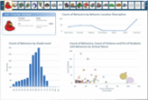
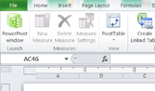
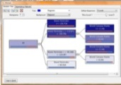
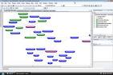
Microsoft Big Data Solution
FAMILIAR END USER TOOLS
Power View
Excel with PowerPivot
Predictive Analytics
Embedded BI
BI PLATFORM
SSAS
SSRS
Microsoft EDW
Connectors
Hadoop On Windows Azure
Hadoop On Windows Server
UNSTRUCTURED & STRUCTURED DATA
Sensors
Devices
Bots
Crawlers
ERP
CRM
LOB
APPs

Slide 16
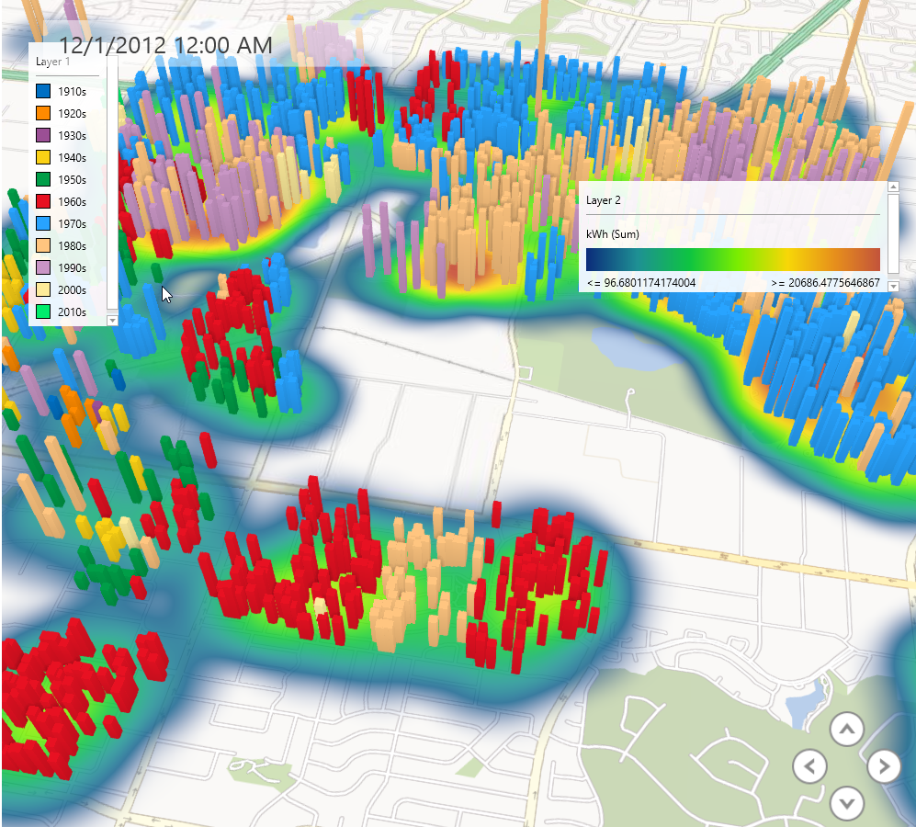
PowerMap

Slide 17
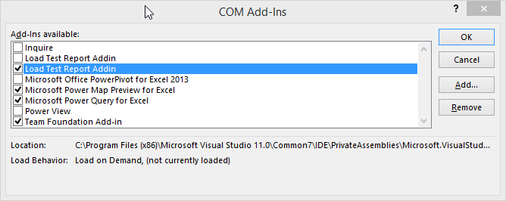
Enable your power tools

Slide 18
Scaling Excel Compute with Windows HPC Server and Windows Azure

Slide 19
Sample Models and Markets
Insurance
Reserve requirements calculation
Data sets from 1000’s to 1 million
4 weeks to calculate (on a monthly schedule)
HPC solution:
Full calculation in 24 hours
Financial
Trade re-pricing
Overnight/cross-market
Est. 4 hours for a subset of trades
HPC Solution
Subset of trades in ~5 minutes
Notes:
Two use cases that demonstrate the dramatic reduction in run time.

Slide 20
Three Ways to Scale out Excel Compute on Windows HPC Server and Windows Azure
Connects to the cluster as a SOA client
VSTO code in workbook calls out to SOA Service
Input and output managed by Excel developer
Run multiple instances of Excel 2010 on an HPC Cluster
Each instance runs an iteration of the same workbook
Can be launched from Excel 2010 or a Windows program
Excel Dialog Suppression
Run User Defined Functions in parallel on a cluster
Excel 2010 includes a new API and options for HPC cluster
Support for .XLL files developed through Excel SDK
Easy to develop on a desktop and deploy to a cluster
Excel SOA Client
Excel workbooks on the Cluster (not yet on Azure)
Excel UDF on the Cluster
Notes:
How do we do this? We provide 2 new ways for Excel to talk to an HPC Server

Slide 21
Supporting Disconnected Clients
Broker
Node
Broker Service
SOA Client
Broker
Compute Node
Store
Get Broker Node list
Head Node
Session Handler
Http or Net.Tcp

Slide 22
Running Hedging Calculation using Excel + Cloud Compute Engine
DEMO

Slide 23
HPC and Excel Resources
DocumentationUnder ‘Featured Content’ on TechNet.
On the Download center
Building VBA applications
Building a custom client and service
Building a SOA .Net application
Converting cluster-safe UDFs for Offloading
HPC V4 Sp1

Slide 24
References
Power Query: http://www.microsoft.com/en-us/download/confirmation.aspx?id=39379
Power Map: http://www.microsoft.com/en-us/download/details.aspx?id=38395

